Slide 1
Social Welfare
A Simple Analysis
Copyright © 2019 Hal R. Varian

Slide 2
Introduction
Last week, we looked at measures of individual welfare for consumers and producers.
Being easily derived, consumer and producer surplus are common measures of measuring welfare of individual consumers and producers respectively.
This week, we will look at analyses of aggregate welfare.
Aggregating welfare measure across individuals
We will focus on the following applications and methodology
Tax regimes.
Comparative statics.
Notes:
How do we evaluate effects on various events on consumer and producers
-> e.g. how well is each country/group dealing with a particular crisis?
-> What are the …
What kind of policies should we implement?
-> In order to make such decisions, we first need some measure of how much consumers/producers have been impacted.
This lecture -> basic tools for covering such an analysis
While still rather simplistic, demand and supply analysis is useful for giving basic intuition for what will happen with exogenous changes to a market.
Of course in real-life, more sophisticated tools will be used, other courses will cover this.

Slide 3
Aggregating Welfare

Slide 4
From individual welfare to aggregate welfare
If we consider multiple producers and consumers, one way to aggregate their welfare is to simply take the sum of the welfare measures across all agents.
For consumers’ surplus, get the area between the market (aggregate) demand curve and the price line. This gives us a measure of aggregate consumer welfare.
For producers’ surplus, get the area between the price line and the market (aggregate) supply curve. This gives us a measure of aggregate producer welfare.
Finally, a simple way to measure social welfare in a single goods market is to look at the sum of consumer and producer surplus.

Slide 5
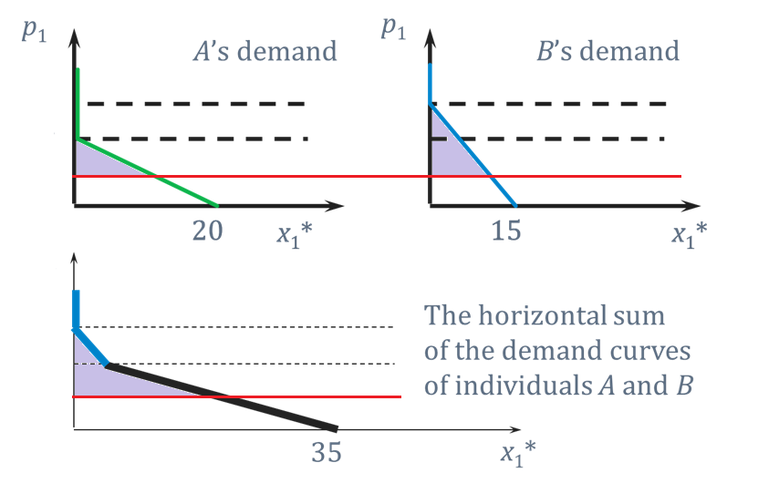

Consumer’s surplus to consumers’ surplus
Shaded purple areas depict consumer surplus.
$$q_{agg}^{D}\left(p\right)=∑q_{i}^{D}(p)$$
Notes:
Be careful to take the correct sum! Common mistake is to take the sum of inverse supply and not supply.

Slide 6
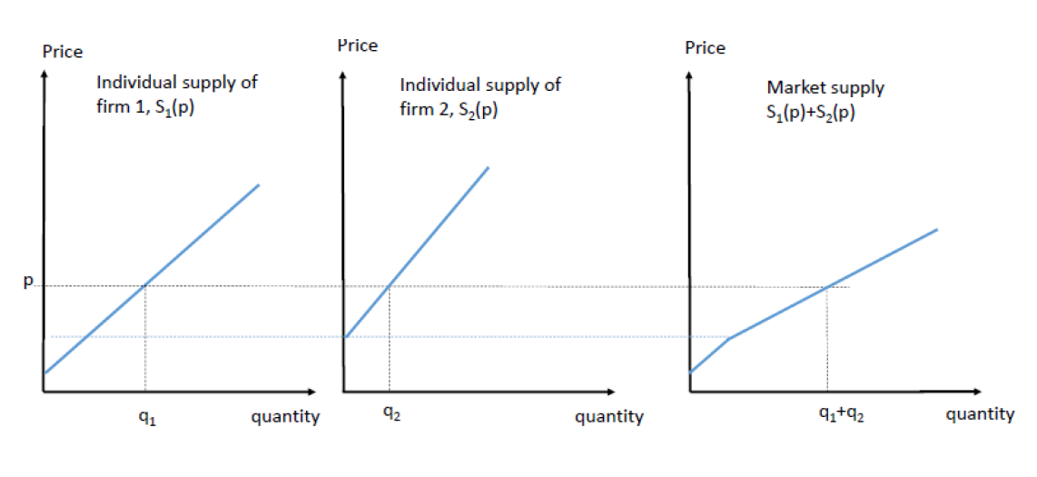






Producer’s Surplus to producers’ surplus
Surplus of all producers in the market is found by getting the corresponding region using the market supply curve.
$$p$$
$$p$$
$$p$$
$$q_{agg}^{S}\left(p\right)=∑q_{i}^{S}(p)$$
$$PS_{1}$$
$$PS_{2}$$
$$PS_{1}+PS_{2}$$

Slide 7
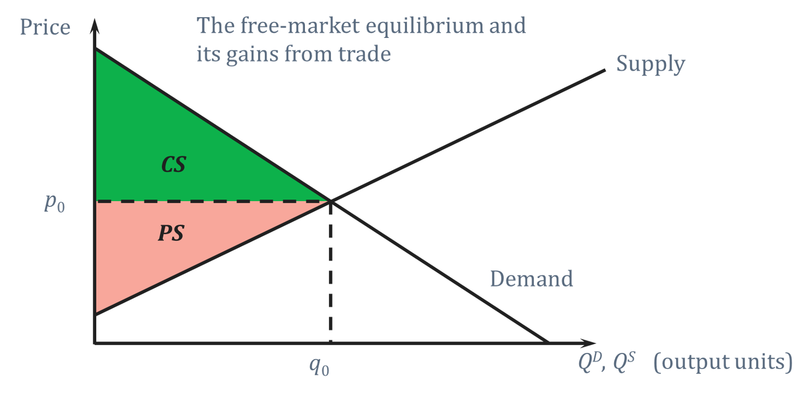
Maximisation of CS+PS
Social welfare in market can be measured as sum of consumers’ surplus and producers’ surplus.
In HE1001, you learnt how social welfare is maximized by the free market equilibrium. (Under certain assumptions)

Slide 8
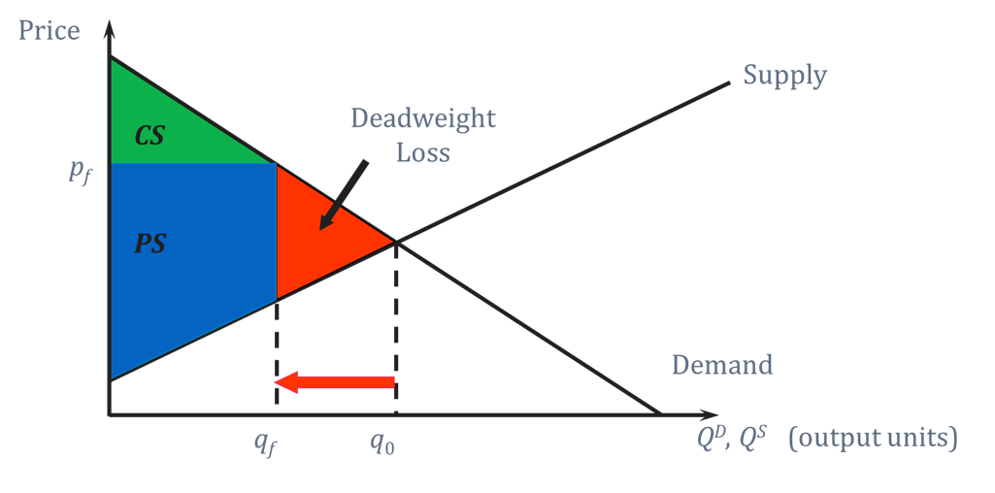
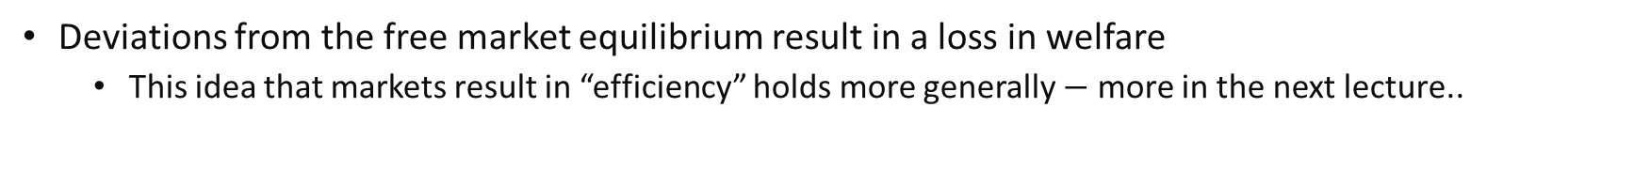

Deadweight Welfare Loss
Deviations from the free market equilibrium result in a loss in welfare
This idea that markets result in “efficiency” holds more generally $−$ more in the next lecture..
Effects of Price Floor $p_{f}$
Notes:
The amount of DWL (the triangles) can be considered to be the minimum amount of welfare loss from a policy which tries to move quantity from the free-market equilibrium $q_{0}$.
Depending on the kind of policy and how it attempts to shift the quantity, perhaps even more surplus might be lost. For example, see 14.10 in the textbook.
In that example, it assumes that even with a price ceiling, consumers face a higher market clearing price (say in the black market).
If there are further potential losses to society from transactions in the black market, then DWL might be larger than the usual triangle.

Slide 9

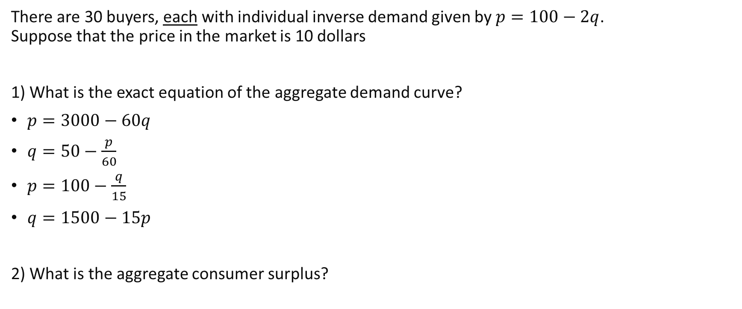
Review questions 1
There are 30 buyers, each with individual inverse demand given by $p=100−2q$. Suppose that the price in the market is 10 dollars
1) What is the exact equation of the aggregate demand curve?
$p=3000−60q$
$q=50−\frac{p}{60}$
$p=100−\frac{q}{15}$
$q=1500−15p$
2) What is the aggregate consumer surplus?

Slide 10
Welfare Analysis under Taxes

Slide 11
Taxes
In the rest of this lecture, we will take a more detailed look at welfare analysis under tax regimes using the CS and PS framework.
Some questions that we will examine:
How is the quantity traded affected?
What is the deadweight welfare loss?
What influences the size of the deadweight welfare loss?
Are consumers or producers more affected by the tax?

Slide 12

Different Kinds of Taxes
A quantity tax is a lump sum tax of $\$t$ paid on each unit traded.
An ad-valorem tax is a percentage tax of $x\%$ paid on the price of the unit.
If the tax is levied on producers (sellers) then it is an excise tax.
If the tax is levied on consumers (buyers) then it is a sales tax.
From now on be careful to keep track of whether prices are before or after taxes are paid to avoid confusion..

Slide 13
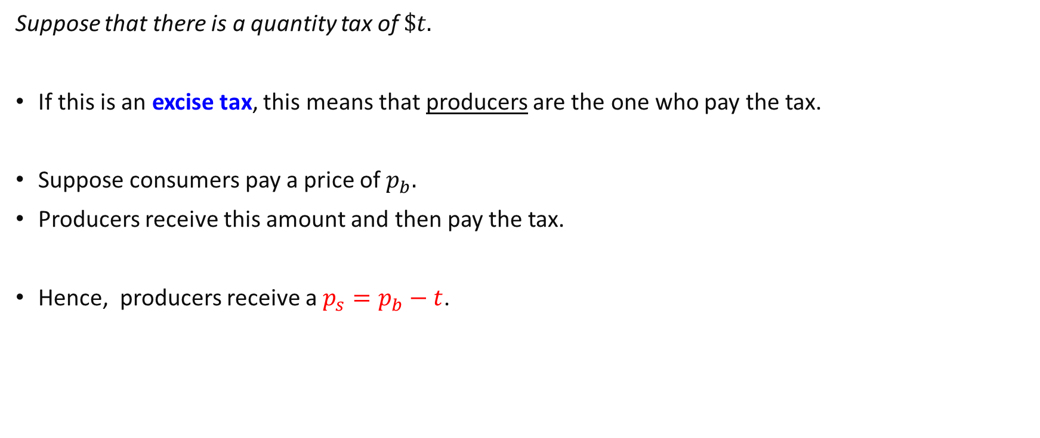
Quantity Taxes
Suppose that there is a quantity tax of $\$t.$
If this is an excise tax, this means that producers are the one who pay the tax.
Suppose consumers pay a price of $p_{b}.$
Producers receive this amount and then pay the tax.
Hence, producers receive a $p_{s}=p_{b}−t$.

Slide 14
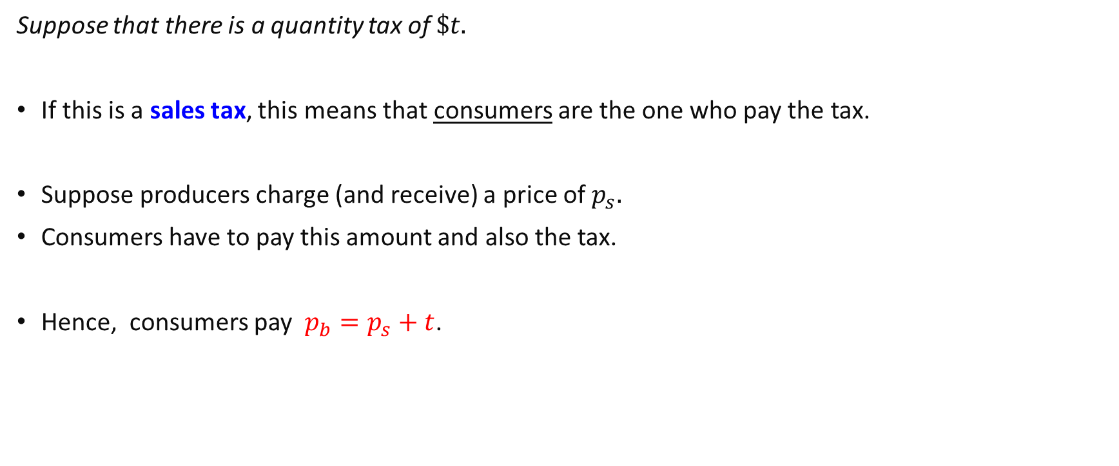
Quantity Taxes
Suppose that there is a quantity tax of $\$t.$
If this is a sales tax, this means that consumers are the one who pay the tax.
Suppose producers charge (and receive) a price of $p_{s}.$
Consumers have to pay this amount and also the tax.
Hence, consumers pay $p_{b}=p_{s}+t$.

Slide 15
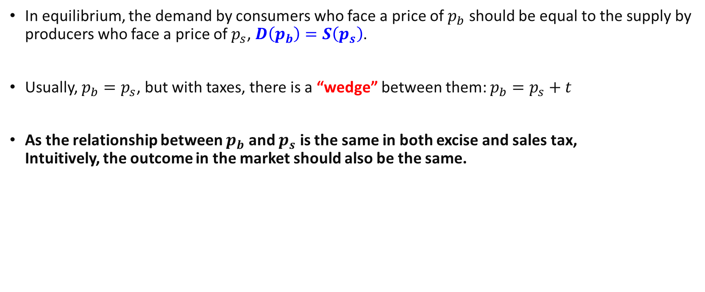
Quantity Taxes and Equilibrium
In equilibrium, the demand by consumers who face a price of $p_{b}$ should be equal to the supply by producers who face a price of $p_{s}$, $D\left(p_{b}\right)=S\left(p_{s}\right)$.
Usually, $p_{b}=p_{s}$, but with taxes, there is a “wedge” between them: $p_{b}=p_{s}+t$
As the relationship between $p_{b}$ and $p_{s}$ is the same in both excise and sales tax, Intuitively, the outcome in the market should also be the same.
Notes:
Notice that without taxes, the equilibrium outcome is just D(p)=S(p) as per normal.

Slide 16
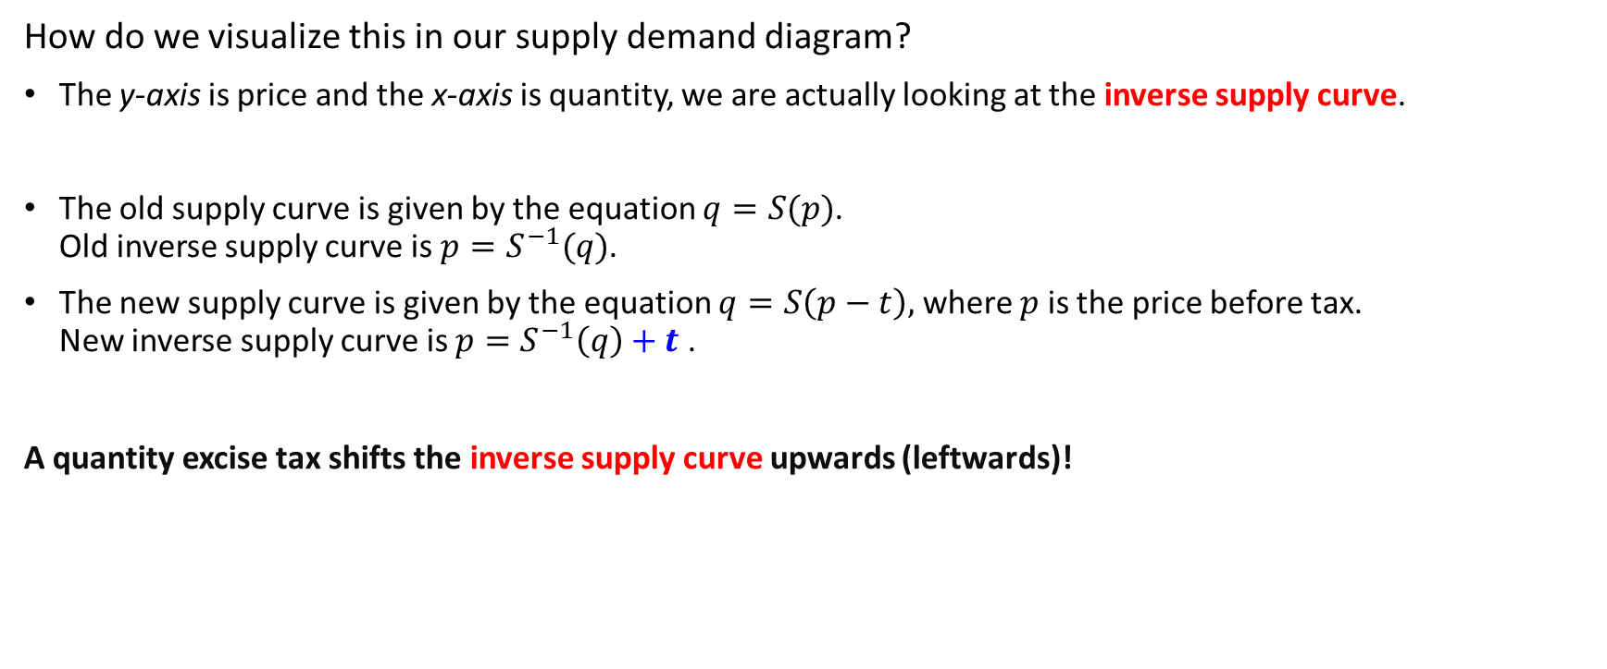
Quantity Excise Taxes and Equilibrium
How do we visualize this in our supply demand diagram?
The y-axis is price and the x-axis is quantity, we are actually looking at the inverse supply curve.
The old supply curve is given by the equation $q=S(p)$. Old inverse supply curve is $p=S^{−1}(q)$.
The new supply curve is given by the equation $q=S\left(p−t\right),$ where $p$ is the price before tax. New inverse supply curve is $p=S^{−1}\left(q\right)+t$ .
A quantity excise tax shifts the inverse supply curve upwards (leftwards)!
Notes:
Note that depending on who the tax is being placed on, whose price is the baseline $p$ changes.
(We focus on the price before tax as the baseline because it allows for a common frame of comparison).

Slide 17








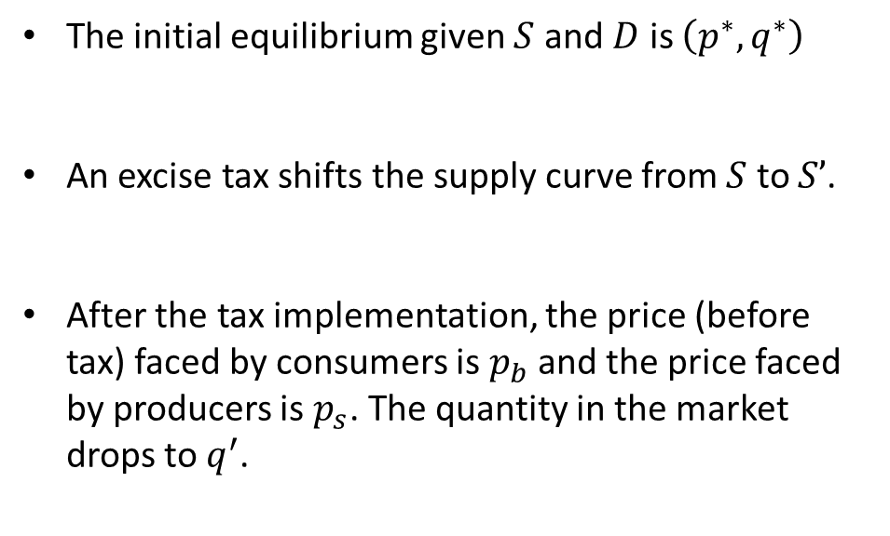



Quantity Excise Taxes and Equilibrium
$$p$$
$$S′$$
$$S$$
The initial equilibrium given $S$ and $D$ is $\left(p^{∗},q^{∗}\right)$
An excise tax shifts the supply curve from $S$ to $S’$.
After the tax implementation, the price (before tax) faced by consumers is $p_{b}$ and the price faced by producers is $p_{s}$. The quantity in the market drops to $q^{′}$.
$$p_{b}$$
$$p^{∗}$$
$$t$$
$$p_{s}$$
$$D$$
$$q$$
$$q′$$
$$q^{∗}$$
Notes:
Note that depending on who the tax is being placed on, whose price is the baseline $p$ changes.
When the tax is on producers, the final equilibrium before tax price is $p_{b}$.
When the tax is on consumers, the final equilibrium before tax price is $p_{s}$.

Slide 18
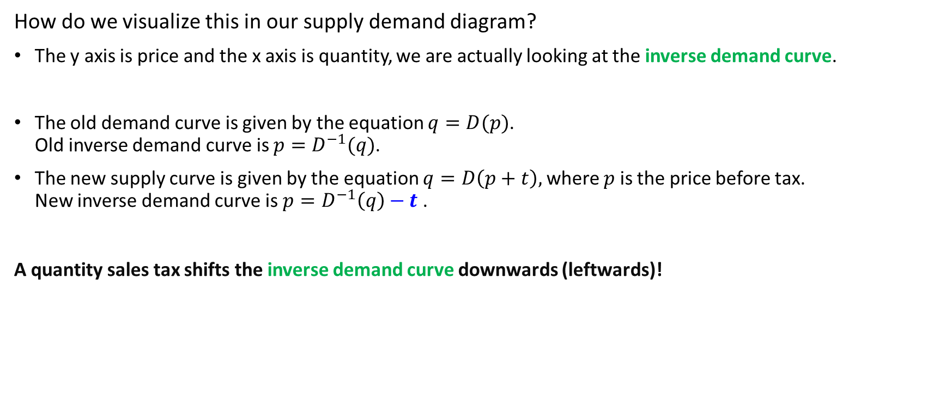
Quantity Sales Taxes and Equilibrium
How do we visualize this in our supply demand diagram?
The y axis is price and the x axis is quantity, we are actually looking at the inverse demand curve.
The old demand curve is given by the equation $q=D(p)$. Old inverse demand curve is $p=D^{−1}(q)$.
The new supply curve is given by the equation $q=D\left(p+t\right),$ where $p$ is the price before tax. New inverse demand curve is $p=D^{−1}\left(q\right)−t$ .
A quantity sales tax shifts the inverse demand curve downwards (leftwards)!

Slide 19
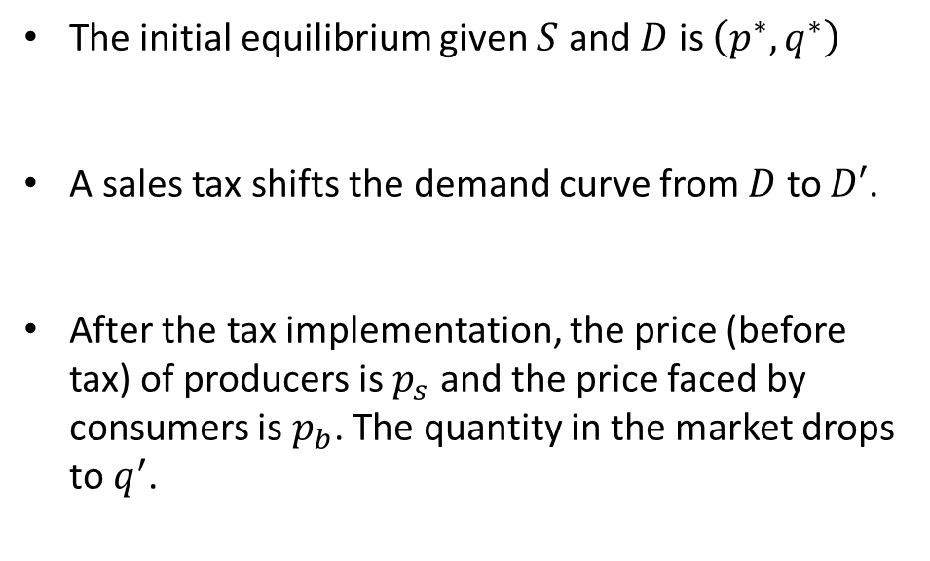

Quantity Sales Taxes and Equilibrium
$$p$$
$$S$$
The initial equilibrium given $S$ and $D$ is $\left(p^{∗},q^{∗}\right)$
A sales tax shifts the demand curve from $D$ to $D′$.
After the tax implementation, the price (before tax) of producers is $p_{s}$ and the price faced by consumers is $p_{b}$. The quantity in the market drops to $q^{′}$.
$$p_{b}$$
$$p^{∗}$$
$$t$$
$$p_{s}$$
$$D′$$
$$D$$
$$q$$
$$q′$$
$$q^{∗}$$
Notes:
Note that depending on who the tax is being placed on, whose price is the baseline $p$ changes.
When the tax is on producers, the final equilibrium before tax price is $p_{b}$.
When the tax is on consumers, the final equilibrium before tax price is $p_{s}$.

Slide 20
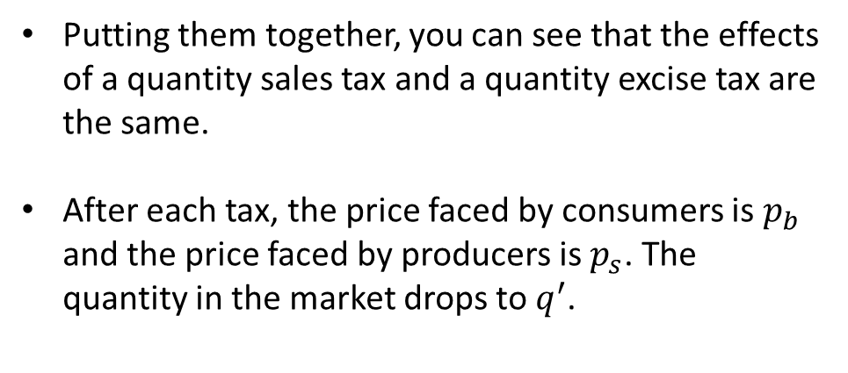
Quantity Taxes and Equilibrium
$$p$$
$$S′$$
$$S$$
Putting them together, you can see that the effects of a quantity sales tax and a quantity excise tax are the same.
After each tax, the price faced by consumers is $p_{b}$ and the price faced by producers is $p_{s}$. The quantity in the market drops to $q^{′}$.
$$p_{b}$$
$$p^{∗}$$
$$t$$
$$p_{s}$$
$$D′$$
$$D$$
$$q$$
$$q′$$
$$q^{∗}$$

Slide 21
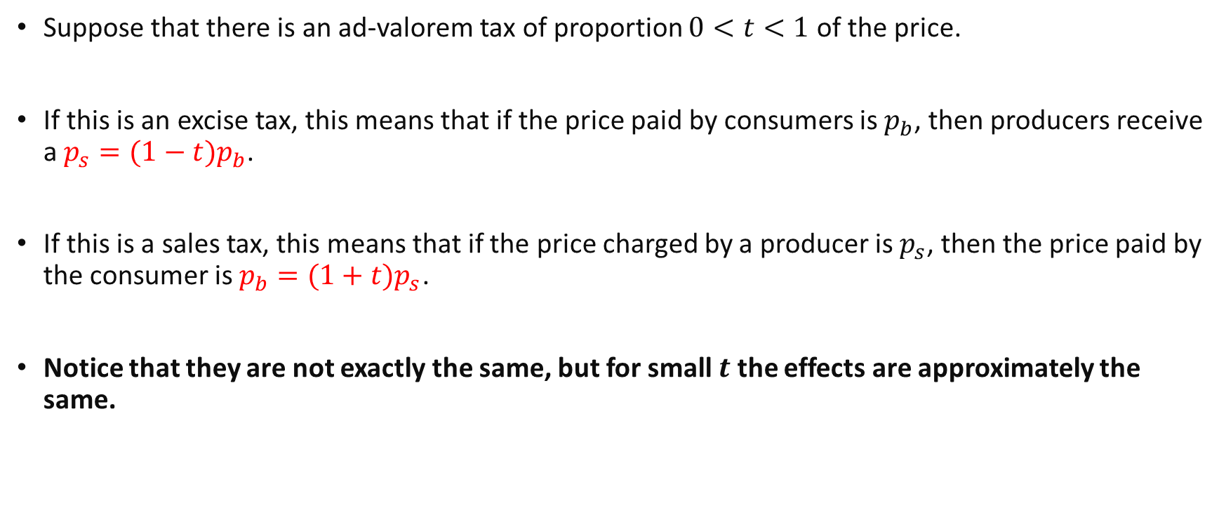
Ad-Valorem (Proportion) Taxes
Suppose that there is an ad-valorem tax of proportion $0<t<1$ of the price.
If this is an excise tax, this means that if the price paid by consumers is $p_{b}$, then producers receive a $p_{s}={(1−t)p}_{b}$.
If this is a sales tax, this means that if the price charged by a producer is $p_{s}$, then the price paid by the consumer is $p_{b}={(1+t)p}_{s}$.
Notice that they are not exactly the same, but for small $t$ the effects are approximately the same.
Notes:
You can derive this using the same principles as before.
When t is small:
1/(1-t) is approximately the same as (1+t)

Slide 22
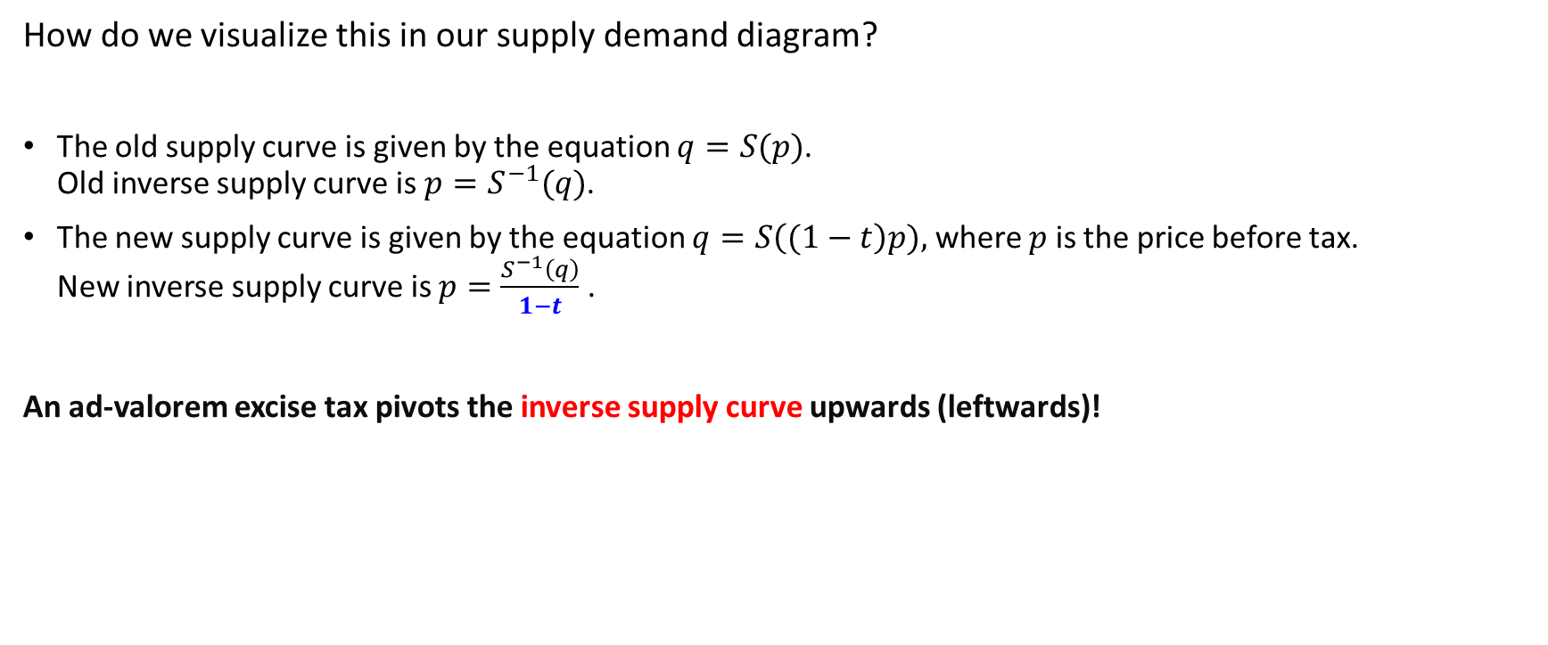
Ad-Valorem Excise Taxes and Equilibrium
How do we visualize this in our supply demand diagram?
The old supply curve is given by the equation $q=S(p)$. Old inverse supply curve is $p=S^{−1}(q)$.
The new supply curve is given by the equation $q=S\left((1−t\right)p),$ where $p$ is the price before tax. New inverse supply curve is $p=\frac{S^{−1}\left(q\right)}{1−t}$ .
An ad-valorem excise tax pivots the inverse supply curve upwards (leftwards)!

Slide 23
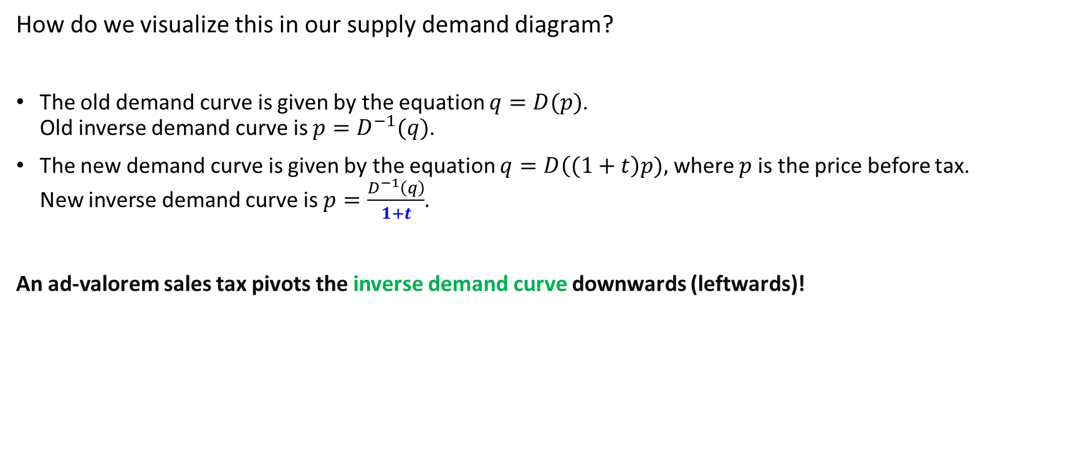
Ad-Valorem Sales Taxes and Equilibrium
How do we visualize this in our supply demand diagram?
The old demand curve is given by the equation $q=D(p)$. Old inverse demand curve is $p=D^{−1}(q)$.
The new demand curve is given by the equation $q=D\left((1+t\right)p),$ where $p$ is the price before tax. New inverse demand curve is $p=\frac{D^{−1}\left(q\right)}{1+t}$.
An ad-valorem sales tax pivots the inverse demand curve downwards (leftwards)!

Slide 24




Ad-Valorem Taxes and Equilibrium
$$p$$
$$S′$$
$$S$$
For ad-valorem taxes, the supply and demand curves pivot instead of shift.
This is because the lower the average value of the item, the lower the per unit tax and vice versa.
$$p^{∗}$$
$$D$$
$$D′$$
$$q$$
$$q^{∗}$$

Slide 25


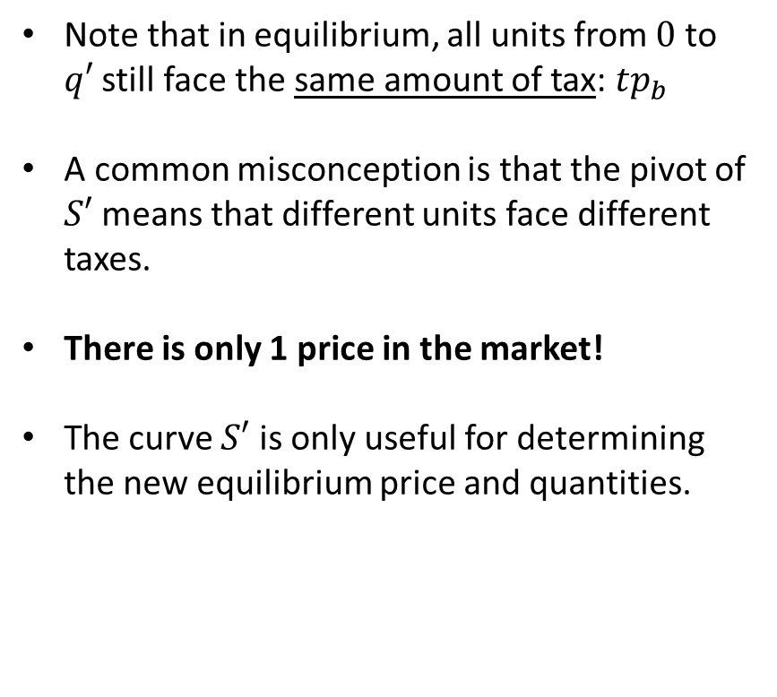


Ad-Valorem Taxes and Equilibrium
$$p$$
$$S′$$
$$S$$
Note that in equilibrium, all units from $0$ to $q′$ still face the same amount of tax: $tp_{b}$
A common misconception is that the pivot of $S′$ means that different units face different taxes.
There is only 1 price in the market!
The curve $S′$ is only useful for determining the new equilibrium price and quantities.
$$p_{b}$$
$$p^{∗}$$
$$tp_{b}$$
$$p_{s}=\left(1−t\right)p_{b}$$
$$D$$
$$D′$$
$$q$$
$$q^{′}$$
$$q^{∗}$$

Slide 26
Review questions 2
A quantity sales tax will have the same welfare effects as a quantity excise tax of similar size.
True
False
An ad-valorem sales tax will have the same welfare effects as an ad-valorem excise tax of similar size.
True
False

Slide 27
The Welfare Effects of Taxes

Slide 28


Quantity Taxes and Deadweight Loss
$$p$$
$$S′$$
$$S$$
Final consumer surplus:
Final producer surplus:
Amount of taxes collected:
Quantity taxes result in a deadweight loss of the area:
$$p_{b}$$
$$p^{∗}$$
$$t$$
$$p_{s}$$
$$D′$$
$$D$$
$$q$$
$$q′$$
$$q^{∗}$$
Notes:
As mentioned earlier, taxes in the absence of any other problems in the market will result in a deadweight welfare loss.
This is because of the frictions it creates in price clearing.

Slide 29

Quantity Taxes and Deadweight Loss
$$p$$
$$S′$$
$$S$$
Final consumer surplus:
Final producer surplus:
Amount of taxes collected:
Quantity taxes result in a deadweight loss of the area:
$$p_{b}$$
$$p^{∗}$$
$$t$$
$$p_{s}$$
These areas are also equivalent.. But be careful.. This only holds for quantity taxes!
$$D′$$
$$D$$
$$q$$
$$q′$$
$$q^{∗}$$
Notes:
As mentioned earlier, taxes in the absence of any other problems in the market will result in a deadweight welfare loss.
This is because of the frictions it creates in price clearing.

Slide 30


Ad-Valorem Taxes and Deadweight loss
$$p$$
$$S′$$
$$S$$
For ad-valorem taxes, if you try to use $S′$ to derive producer surplus like on the previous slide, it will not be correct!
This is because $S′$ does not represent the true costs incurred by producers.
$$p_{b}$$
$$p^{∗}$$
$$tp_{b}$$
$$p_{s}=\left(1−t\right)p_{b}$$
$$D$$
$$D′$$
$$q$$
$$q^{′}$$
$$q^{∗}$$

Slide 31
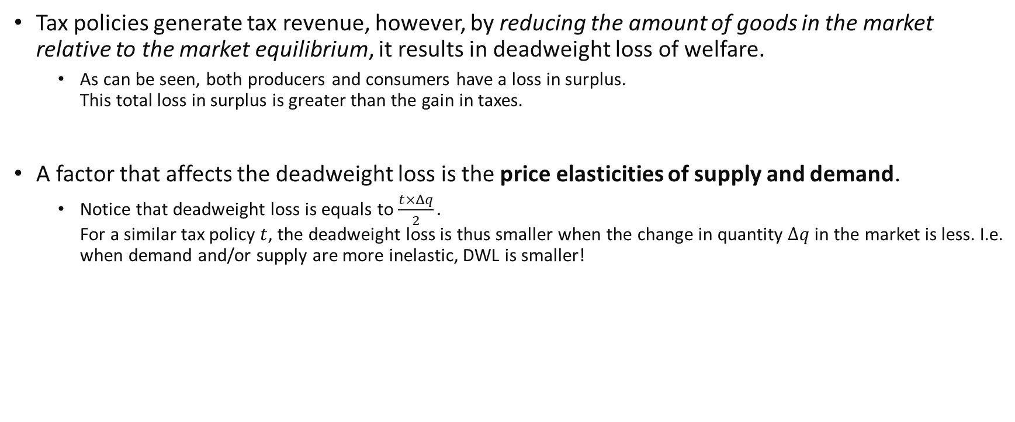
Quantity Taxes and Deadweight Loss
Tax policies generate tax revenue, however, by reducing the amount of goods in the market relative to the market equilibrium, it results in deadweight loss of welfare.
As can be seen, both producers and consumers have a loss in surplus. This total loss in surplus is greater than the gain in taxes.
A factor that affects the deadweight loss is the price elasticities of supply and demand.
Notice that deadweight loss is equals to $\frac{t×Δq}{2}.$ For a similar tax policy $t$, the deadweight loss is thus smaller when the change in quantity $Δq$in the market is less. I.e. when demand and/or supply are more inelastic, DWL is smaller!
Notes:
Intuitively, this is because inelasticity means that the government is able to collect taxes without disrupting the market too much!

Slide 32
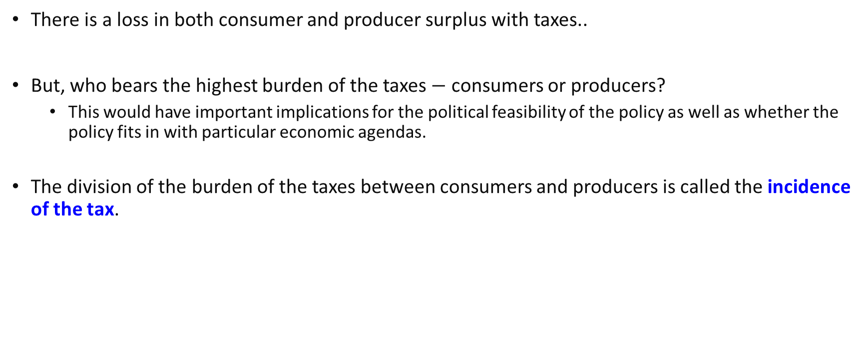
Incidence of Taxes
There is a loss in both consumer and producer surplus with taxes..
But, who bears the highest burden of the taxes $−$ consumers or producers?
This would have important implications for the political feasibility of the policy as well as whether the policy fits in with particular economic agendas.
The division of the burden of the taxes between consumers and producers is called the incidence of the tax.

Slide 33
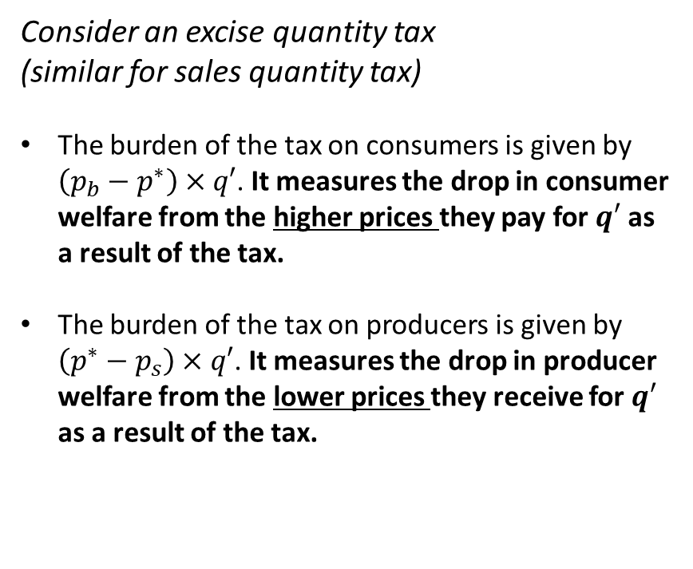
Incidence of Taxes
$$p$$
$$S′$$
Consider an excise quantity tax (similar for sales quantity tax)
The burden of the tax on consumers is given by $\left(p_{b}−p^{∗}\right)×q′$. It measures the drop in consumer welfare from the higher prices they pay for $q′$ as a result of the tax.
The burden of the tax on producers is given by $\left(p^{∗}−p_{s}\right)×q′$. It measures the drop in producer welfare from the lower prices they receive for $q′$ as a result of the tax.
$$S$$
$$p_{b}$$
$$p^{∗}$$
$$t$$
$$p_{s}$$
$$D$$
$$q$$
$$q′$$
$$q^{∗}$$

Slide 34



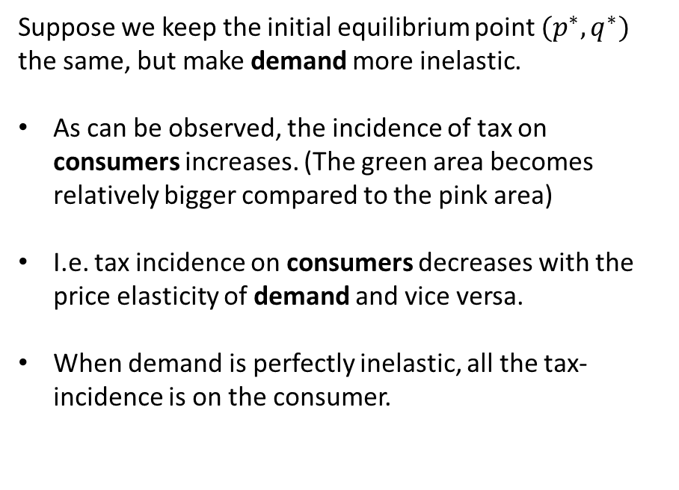
Elasticity and Incidence of Taxes
$$p$$
$$S′$$
Suppose we keep the initial equilibrium point $(p^{∗},q^{∗})$ the same, but make demand more inelastic.
As can be observed, the incidence of tax on consumers increases. (The green area becomes relatively bigger compared to the pink area)
I.e. tax incidence on consumers decreases with the price elasticity of demand and vice versa.
When demand is perfectly inelastic, all the tax-incidence is on the consumer.
$$S$$
$$p_{b}$$
$$p^{∗}$$
$$t$$
$$p_{s}$$
$$D$$
$$q$$
$$q′$$
$$q^{∗}$$

Slide 35




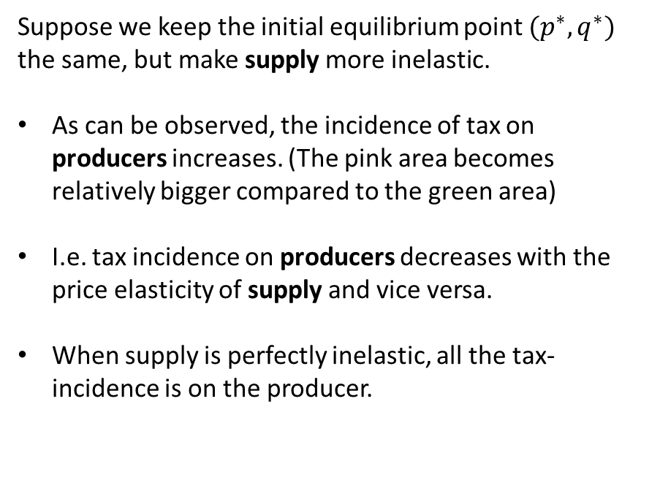
Elasticity and Incidence of Taxes
$$p$$
$$S′$$
Suppose we keep the initial equilibrium point $(p^{∗},q^{∗})$ the same, but make supply more inelastic.
As can be observed, the incidence of tax on producers increases. (The pink area becomes relatively bigger compared to the green area)
I.e. tax incidence on producers decreases with the price elasticity of supply and vice versa.
When supply is perfectly inelastic, all the tax-incidence is on the producer.
$$S$$
$$p_{b}$$
$$p^{∗}$$
$$t$$
$$p_{s}$$
$$D$$
$$q$$
$$q′$$
$$q^{∗}$$

Slide 36
Comparative Statics

Slide 37
Comparative Statics
We have (graphically) looked at how elasticity of demand and supply influenced economic outcomes like the incidence of taxes or deadweight welfare loss.
This is an example of performing comparative statics: Examining what happens to outcomes if we change parts of the environment, holding other factors constant.
This is an important tool in economic analysis:
Can predict how a particular policy will have different effects in different settings.
Predictions can be used as a test of the validity of a particular model using real-world data.
In the following slides, we will demonstrate some examples of performing comparative statics, mathematically.

Slide 38
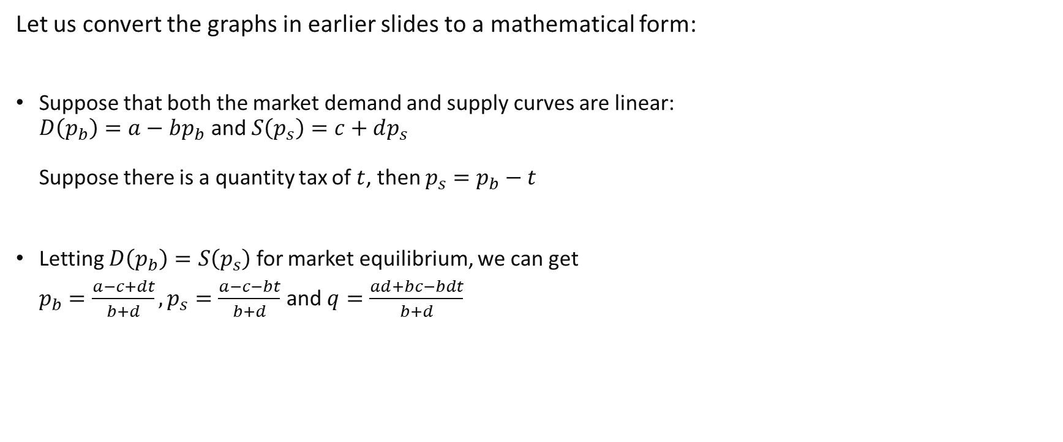
Example 1: Elasticities and Tax incidence
Let us convert the graphs in earlier slides to a mathematical form:
Suppose that both the market demand and supply curves are linear: $D\left(p_{b}\right)=a−bp_{b}$ and $S\left(p_{s}\right)=c+dp_{s}$ Suppose there is a quantity tax of $t$, then $p_{s}=p_{b}−t$
Letting $D\left(p_{b}\right)=S\left(p_{s}\right)$ for market equilibrium, we can get $p_{b}=\frac{a−c+dt}{b+d}, p_{s}=\frac{a−c−bt}{b+d}$ and $q=\frac{ad+bc−bdt}{b+d}$
Notes:
How do we get the original equilibrium price p*, q*?
Substitute t=0.

Slide 39
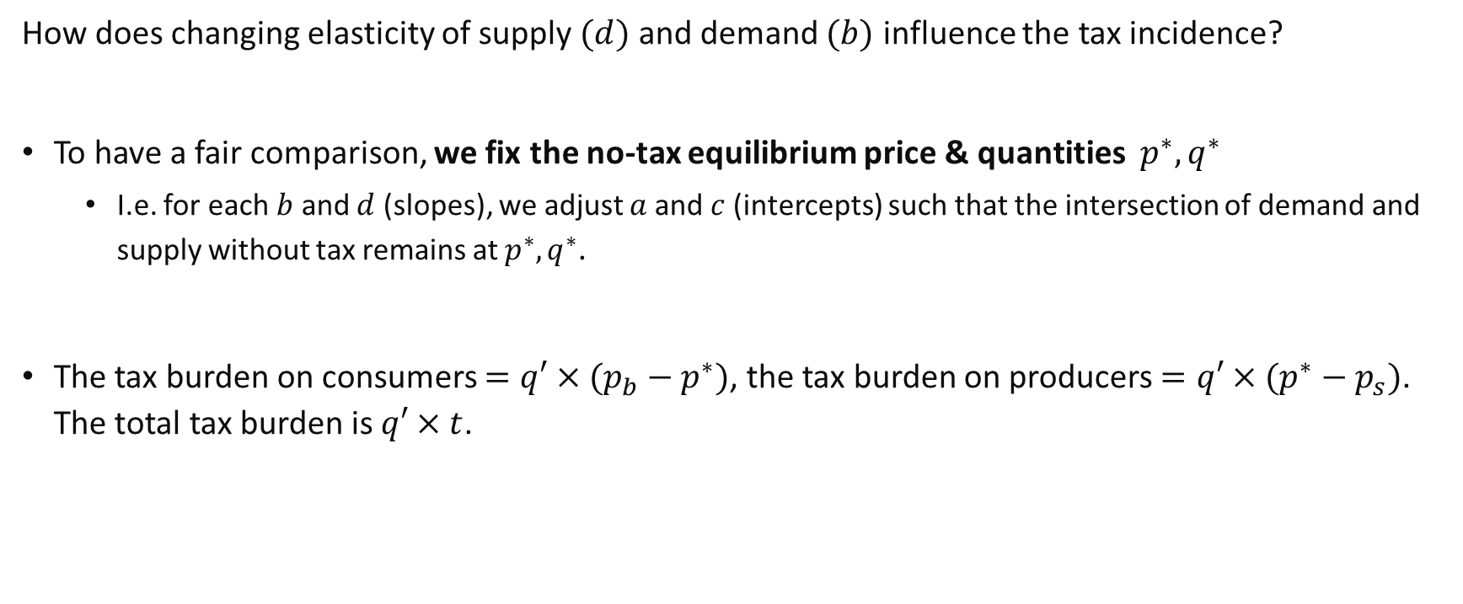
Example 1: Elasticities and Tax incidence
How does changing elasticity of supply $(d)$ and demand $(b)$ influence the tax incidence?
To have a fair comparison, we fix the no-tax equilibrium price & quantities $p^{∗},q^{∗}$
I.e. for each $b$ and $d$ (slopes), we adjust $a$and $c$ (intercepts) such that the intersection of demand and supply without tax remains at $p^{∗},q^{∗}$.
The tax burden on consumers $=q′×(p_{b}−p^{∗})$, the tax burden on producers $=q′×(p^{∗}−p_{s})$. The total tax burden is $q′×t$.
Notes:
This means that a and c will just be functions of b and d.

Slide 40
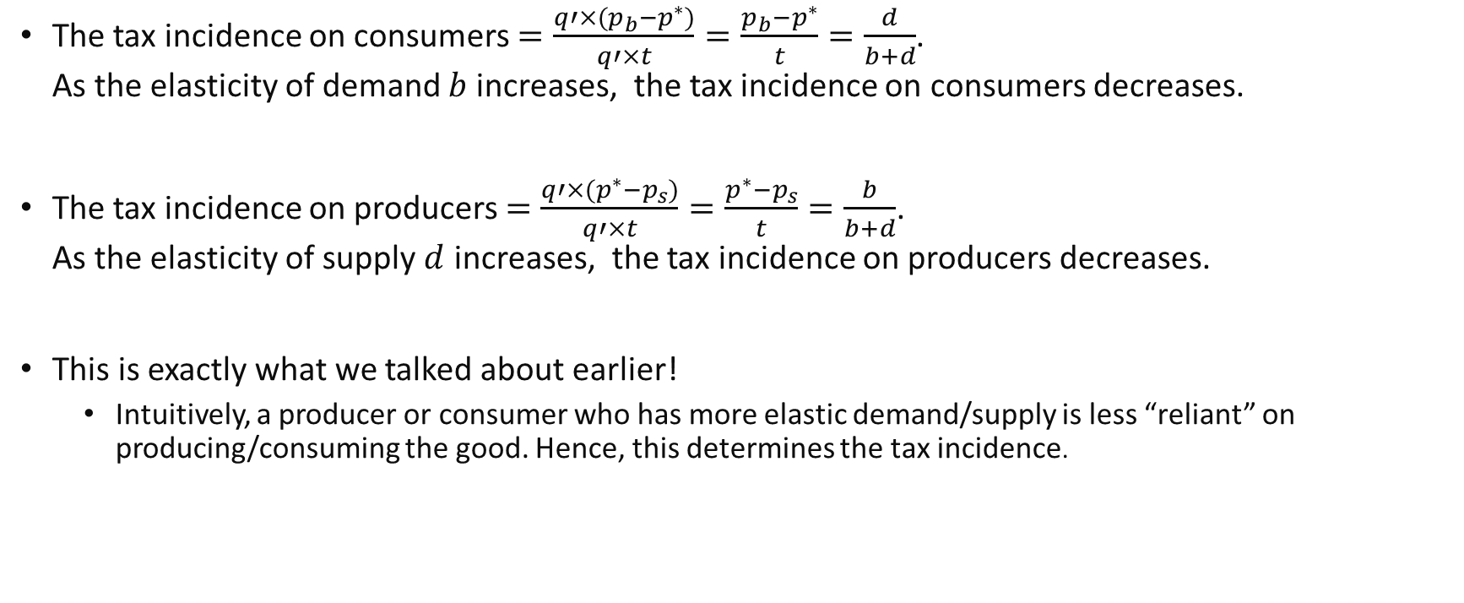
Example 1: Elasticities and Tax incidence
The tax incidence on consumers $=\frac{q′×(p_{b}−p^{∗})}{q′×t}=\frac{p_{b}−p^{∗}}{t}=\frac{d}{b+d}$. As the elasticity of demand $b$ increases, the tax incidence on consumers decreases.
The tax incidence on producers $=\frac{q′×(p^{∗}−p_{s})}{q′×t}=\frac{p^{∗}−p_{s}}{t}=\frac{b}{b+d}$. As the elasticity of supply $d$ increases, the tax incidence on producers decreases.
This is exactly what we talked about earlier!
Intuitively, a producer or consumer who has more elastic demand/supply is less “reliant” on producing/consuming the good. Hence, this determines the tax incidence.
Notes:
d/(b+d)>1/2 if 2d>b+d or d>b.

Slide 41
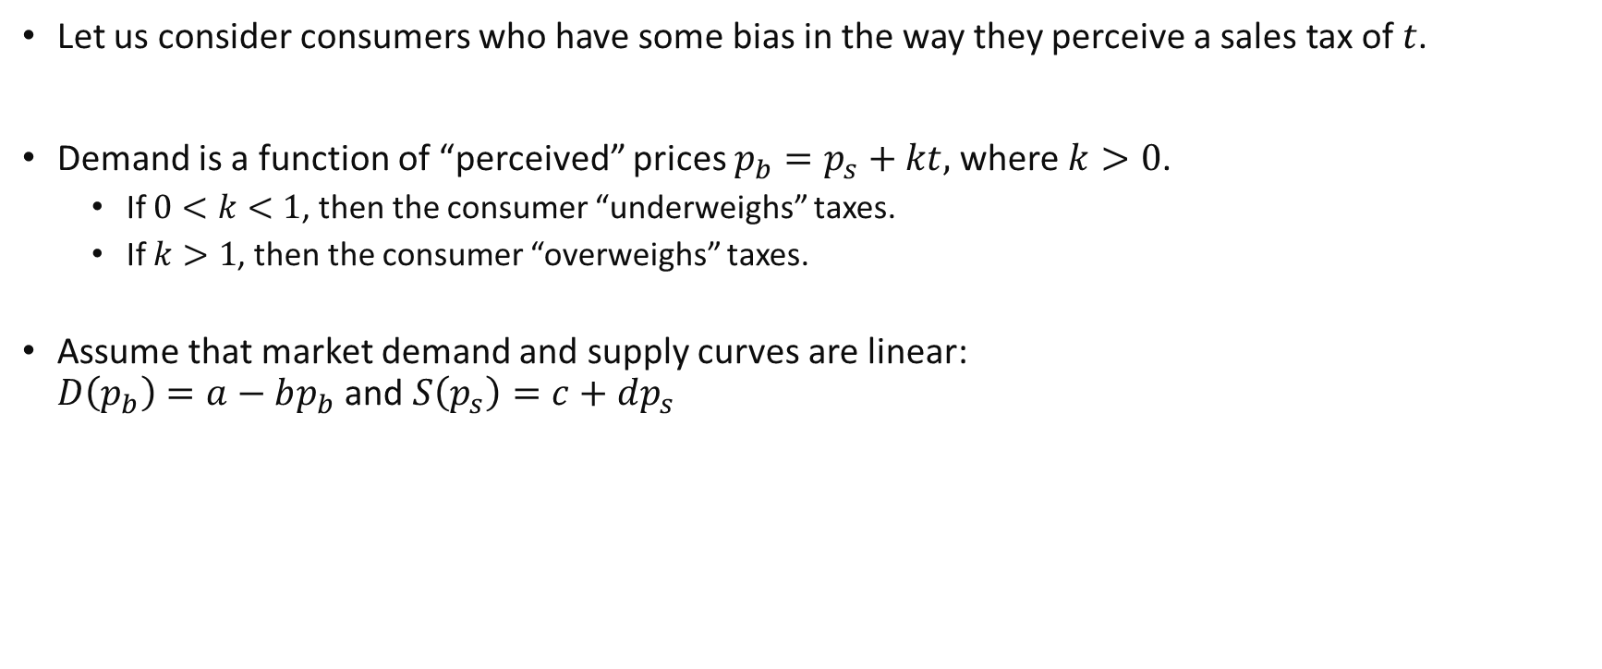
Example 2: Behavioral Biases and Tax Collected
Let us consider consumers who have some bias in the way they perceive a sales tax of $t$.
Demand is a function of “perceived” prices $p_{b}=p_{s}+kt,$where $k>0$.
If $0<k<1$, then the consumer “underweighs” taxes.
If $k>1$, then the consumer “overweighs” taxes.
Assume that market demand and supply curves are linear: $D\left(p_{b}\right)=a−bp_{b}$ and $S\left(p_{s}\right)=c+dp_{s}$

Slide 42

Example 2: Behavioral Biases and Tax Collected
What is the market equilibrium?
$D\left(p_{s}\right)=a−b(p_{s}+kt)$
$S\left(p_{s}\right)=c+dp_{s}$
There is equilibrium in the market when these are the same.
Solving we get:
$$p_{s}=\frac{a−c−bkt}{b+d}, p_{b}=\frac{a−c+dkt}{b+d}$$
$$Q=\frac{bc+ad−bdkt}{b+d}$$
Notes:
Notice that the solution is similar to that in example 1, but with all tax terms now being weighed by $k$. Intuitively, the bias effects on quantity are similar to a similar change in taxes.

Slide 43
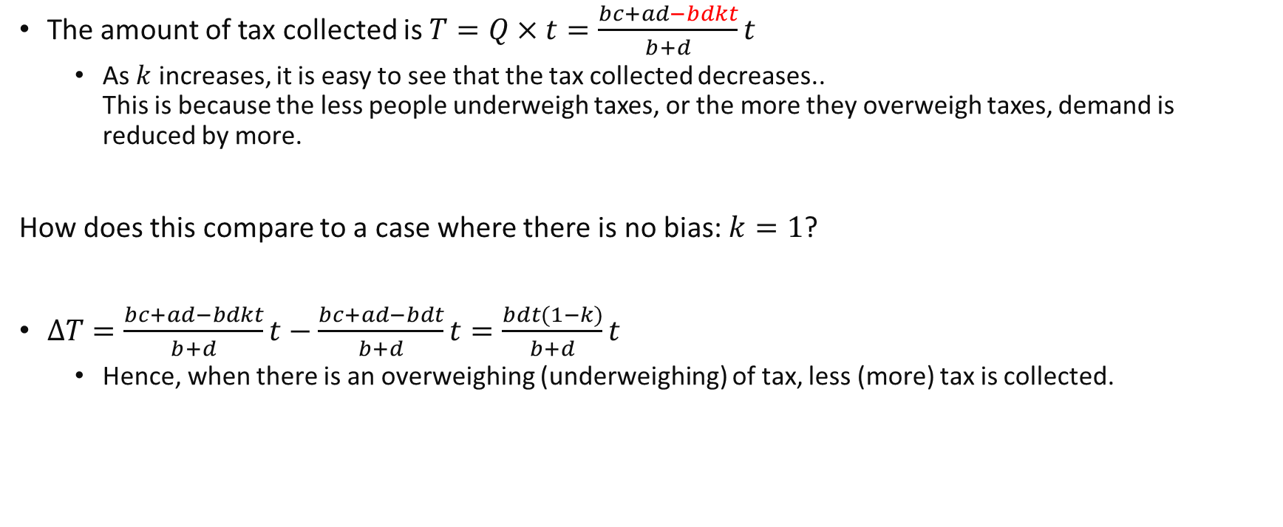
Example 2: Behavioral Biases and Tax Collected
The amount of tax collected is $T=Q×t=\frac{bc+ad−bdkt}{b+d}t$
As $k$ increases, it is easy to see that the tax collected decreases.. This is because the less people underweigh taxes, or the more they overweigh taxes, demand is reduced by more.
How does this compare to a case where there is no bias: $k=1$?
$ΔT=\frac{bc+ad−bdkt}{b+d}t−\frac{bc+ad−bdt}{b+d}t=\frac{bdt(1−k)}{b+d}t$
Hence, when there is an overweighing (underweighing) of tax, less (more) tax is collected.
Notes:
Effects can be more complex for the interaction between a change in tax rate and change in bias.

Slide 44
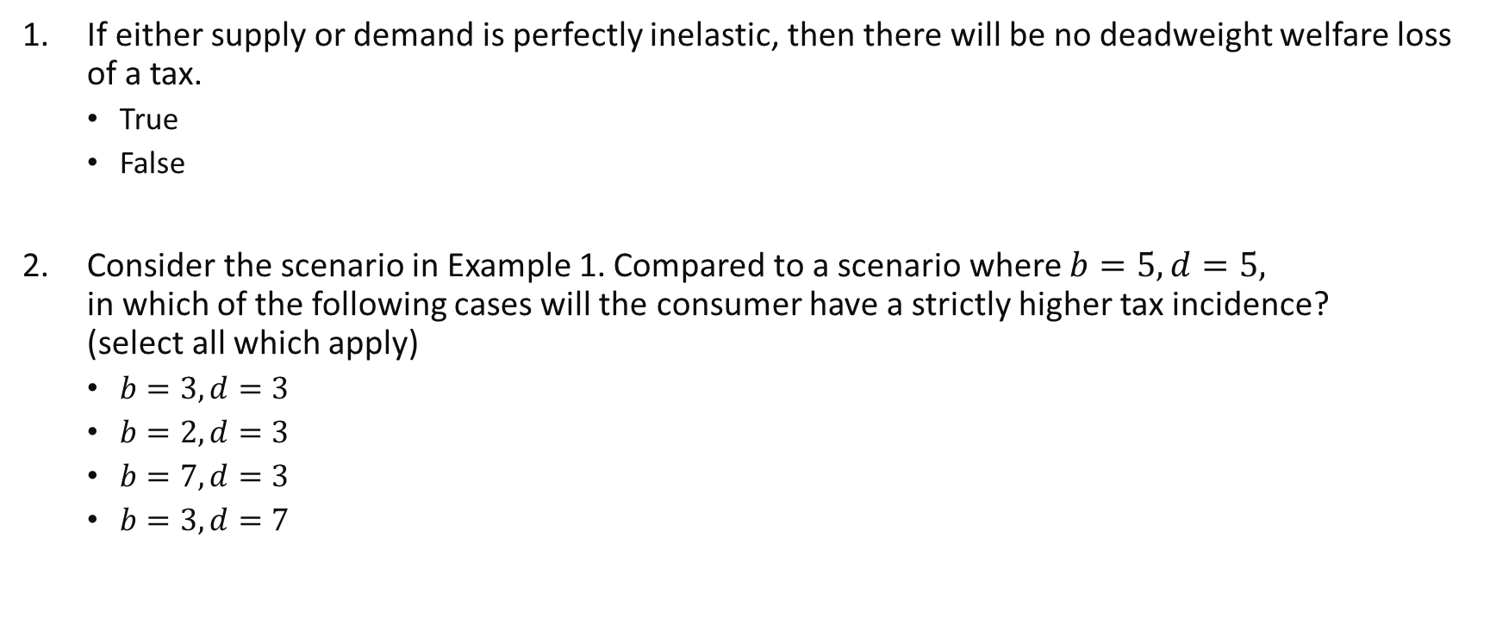
Review questions 3
If either supply or demand is perfectly inelastic, then there will be no deadweight welfare loss of a tax.
True
False
Consider the scenario in Example 1. Compared to a scenario where $b=5, d=5,$ in which of the following cases will the consumer have a strictly higher tax incidence? (select all which apply)
$b=3,d=3$
$b=2,d=3$
$b=7,d=3$
$b=3,d=7$

Slide 45
Key Learning Outcomes
How do we aggregate our measures of welfare from the individual level to the aggregate level?
What are the differences for per-unit vs ad-valorem taxes, excise vs sales taxes?
How do we analyse changes in consumer and producer welfare in a demand-supply framework?
Extension to other kinds of policies which cause price changes.
Generally, what would be the effects of intervening in the market?
How to perform comparative statics given a “theoretical” economic environment.

Slide 46

Readings
Varian Chapter 14, last part.
Varian Chapter 16, part on taxes
Varian Chapter 17 (optional) $−$ applied data analysis methods.

